Slide 1

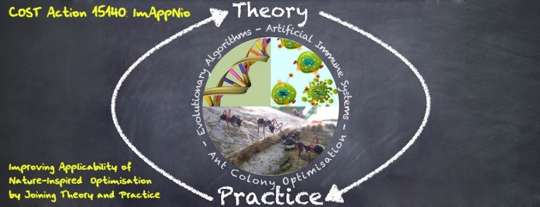

Unsupervised Machine Learning
Alberto TONDA, INRA(E), Université Paris-Saclay France

Slide 2
Unsupervised?
In supervised ML, training was labeled
We know the corresponding class of a sample
We know the value of a sample in regression
Unsupervised ML, there is no «ground truth»
We have data
We suspect there is exploitable regularity in data

Slide 3
Dimensionality Reduction
Very often, datasets have lots of features
If we take feature -> dimension
We cannot plot/understand more than 3!
Dimensionality reduction techniques
New features (combinations of existing features)
Make high-dimensional datasets readable

Slide 4
Principal Component Analysis
Classic and widely adopted
New features = linear combinations
Fit linear regression
Obtain hyperplane
Find other perpendicular hyperplanes

Slide 5
Example: PCAs

Slide 6
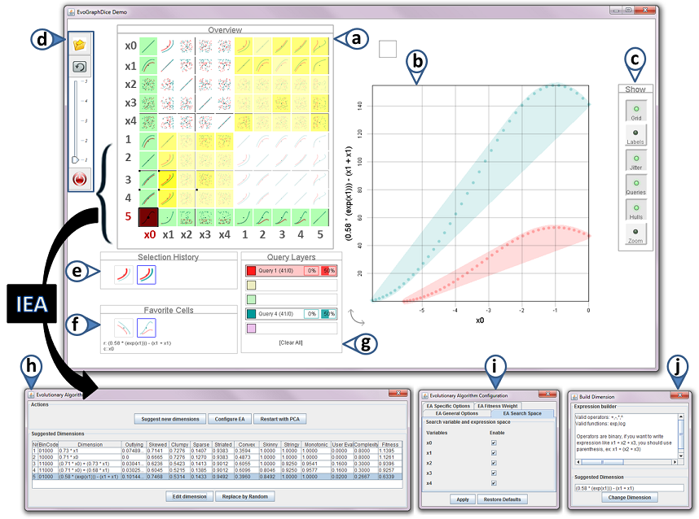
Interactive Evolutionary Dimensionality Reduction
EvoGraphDice
Uses Symbolic Regression to create dimensions
Feedback from the user (interactive)
Unfortunately, no demo
But there is a video!
https://aviz.fr/EVE

Slide 7
Self-Encoder

Slide 8
Clustering

Slide 9
Evolutionary Cluster Description
After obtaining clusters, describe them?
Find minimal set of rules that fully define cluster
Example from clustering malware
Large amounts of malware
Can be clustered together in «families»
Generate rules to identify them that cover most of the malware in the same cluster

Slide 10
Evolutionary Cluster Description
"Countering Android Malware: a Scalable Semi-Supervised Approach for Family-Signature Generation" Marcelli et al., 2019
https://github.com/jimmy-sonny/YaYaGen

